Slide 1




Joey Soccer 2021

Slide 2
About UWA Nedlands Football Club
One of the largest football clubs in Western Australia
Established following the merger between Nedlands FC and UWA Soccer Club in 2011
Over 1,500 members
Offering an opportunity to play football for boys, girls, men and women of all age and ability
In 2021 our youngest member will be 4 and our oldest member will be 66 years of age
Everyone is welcome at UWA Nedlands FC

Slide 3
About Joey Soccer
About Joey Soccer
Started in 2009
Primary School based (over 25 primary schools participate)
Almost 900 kids participating in 2021
Based on the Football Federation Australia (FFA) small-sided games (SSG) model
Joey Soccer is about:
Fun, football sessions that build fundamental motor skills;
Activities aim to improve confidence and self-esteem;
Make new friends and develop fundamental social skills;
Develop values of team work, cooperation, fair play, and respect for others;
Keep healthy by getting active;

Slide 4
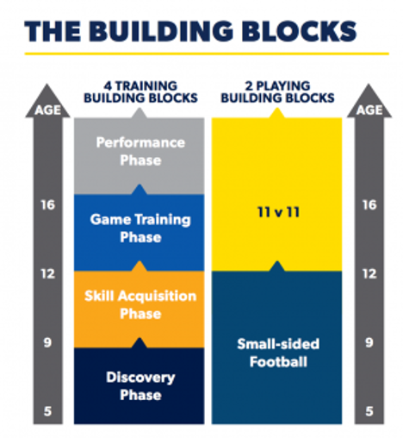
About Joey Soccer
Discovering a love for football
Joey Soccer is part of the Discovery phase of football development (4-9 years)
Emphasis is on building a love of the game (and playing sports more generally)
There should be little to no coaching
Characteristics of children in this age bracket
They are still ‘clumsy’ (lack fine motor skills), because they are still developing their coordination
They have a short span of attention and are quickly and easily distracted
They are ‘self-centred’ and not yet able to really work together (so do not ask them to perform team play, it is impossible for them!)
They play or participate for fun with short bursts of energy and enthusiasm
They are unable to handle a lot of information (instructions; feedback)

Slide 5
Game Day
Session 1 | Session 2
1:15 Warm up/Training Session | 2.45 Warm up/Training
1:30 Start of First Half | 3:00 Start of first half
1:50 Half Time | 3:20 Half time
1:55 Start of Second Half | 3:25 Start of Second Half
2:15 Finish | 3:45 finish
Each Team assist once during the season in setting up the pitches and once in packing goals away. Set up for the first session starts at 1:00 (please make sure you are on time if your team is rostered on), pack up after the last session is to be completed at 4:00.

Slide 6
Training
Each Joey Soccer sessions starts with 15 minutes of training
These 15 minutes are a great opportunity to play fun games that get the kids warmed up and to work on some skills such as dribbling and shooting
This is also a great opportunity for parents to join in the fun so make the most of it!
A handbook with a range of games has been attached to this email and we strongly encourage you to try some of the games out
Keep it simple and remember that kids love to race each other, testing their skills against each other and opportunities to kick the ball on goal
The ‘Ball Thief’, ‘Cops and Robbers’ and ‘Cat and Mouse’ are some great examples

Slide 7
The Game
No scores are kept
Players can be rotated on and off at any time during the game
Good practice is to allocate equal playing time across all players irrespective of ability
Close games are the most fun for both teams so if one of the teams is much stronger than the other one consider making it a 6v5 to create a more even game
Scoring goals is only a small (although important!) part of the game so encouraging and praising passing, dribbling, defending, trying and putting in a good effort will give the players a greater sense of satisfaction
There is no such thing as to many high fives!

Slide 8
The Game for Kindy Teams
Playing for the first time can be a bit scary and stressful for some children
A big pitch, cheering parents and not really knowing what to do
Defending (hiding in) the goal can give a sense of safety, particularly when you are there with 1 or more of your team mates
Gentle encouragement is the way to go, forcing kids can have the adverse effect
If a child does not want to get onto the pitch then maybe they could hold their parents hand and have a go
Giving shy kids a chance to take a kick in, goal kicks and kick offs and abundantly praising them helps build their confidence a bit at a time
Taking a moment after every game and recognising the contribution of each child will help to further build confidence (and having a snake as a reward is guaranteed to bring the smiles out)

Slide 9
Coaching Tips
Be enthusiastic If you look like you are having a good time, it will generally follow that the kids will have a good time. Try to show the children that there is no place you would rather be than on the field with them.
Be friendly The kids need to feel that you are on their side, as a friend as well as a mentor. Make sure you greet every player on arrival and say goodbye to every player when they leave, thanking them for their efforts in the session.
Show your sense of humour Fun is the key word; young players are not preparing for the World Cup, so let them enjoy themselves. Letting the children see you laugh is a great way of showing them you are a warm, likeable person.
Respect every individual Children need to feel valued, which helps them develop self-confidence during this key phase of their social growth.
Give lots of praise Praise is not only given for doing something well; it should also be used to recognise effort.
Encourage after mistakes never see the kids’ errors or mistakes as negatives. Everything that happens is a learning experience. Young players can learn just as much from a miskick or loss of possession as from a successful shot at goal.
Display excellent social skills Your behaviour is usually imitated by children, so make sure you are a good role model. Be polite, respectful, calm and no pressure. Communicate with each player individually, and talk regularly to their parents.
Be patient Training with younger age groups can be frustrating at times, so remember that patience is a virtue. Don’t have unrealistic expectations – expect things to go wrong. Usually, it’s not their intent to stop things working, it’s just their age

Slide 10
The Location
Fixtures are available on the website https://www.uwanfc.com.au/joey-fixtures-2021
Manned information Desk (east and west side)
Toilets
Coffee and food vans

Slide 11
Our Sponsors
We are grateful for the support of our sponsors TES Electrical and Tonia McNeilly, without whom we could not make this great community-building event happen
Tonia McNeilly is in her 7th year of Joey Soccer, please consider Tonia if you are thinking about selling your home http://www.toniamcneillyproperty.com.au/

